Slide 1

Probability of Loan Defaults
By Cody Osieczonek, Tyler White and Lauren Amoroso

Slide 2

Objective
We chose to train a model with machine learning using the bank loan status dataset to predict the probability of a loan defaulting based on the following data:
Credit score
Annual income
Monthly income
Monthly debt
Monthly debt vs monthly income (debt to income ratio)
Current loan amount
Current credit balance
Total credit
Current credit balance vs max open credit (credit usage ratio)
Whether there had been past bankruptcies or not.
Number of credit problems
Number of open accounts
Months since last delinquent
Credit history (years)

Slide 3
Data Collection and Cleanup
We found our dataset on Kaggle.com: https://www.kaggle.com/datasets/zaurbegiev/my-dataset?select=credit_test.csv
We filtered our dataset and added two additional columns for Debt-to-Income Ratio and Credit Usage Ratio
We updated the Bankruptcy column to only have 1 and 0 outputs so we could support a true/false statement
We removed rows 454, 539, 1754, 2682, 5863, 7085 and 9970 from the dataset as we believed it to contain erroneous data under the “Total credit” and “Credit balance” columns. For example, row 454 showed a credit balance of $515,261 even though available credit was 0. Due to this when we went to create the new column called “credit usage ratio” and have its values be equal to “credit balance / total credit” it caused it to give values of “inf” since the value would be undefined.

Slide 4
Original Dataset Before Cleanup

Slide 5
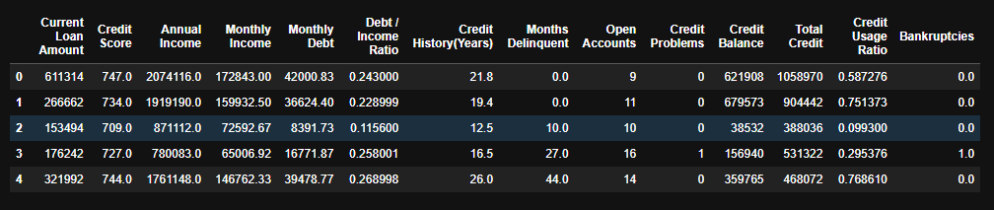
Dataset After Cleanup/ETL Work

Slide 6
Machine Learning
A bias towards false positives is preferred because from a lender’s standpoint because the fallout of approving loans with a higher possibility of defaulting would cost the banks more money overall vs taking a closer look at loans that could potentially default by the factors we are taking into account. As such a higher precision accuracy score is more desirable.
We experimented with using several different machine learning algorithms to see which one trained the data with the highest precision accuracy score. In the next three slides we will compare the classification reports for the models using the logistic regression, kneighbors and random forest algorithms to see which one would be more reliable in this sort of a scenario

Slide 7
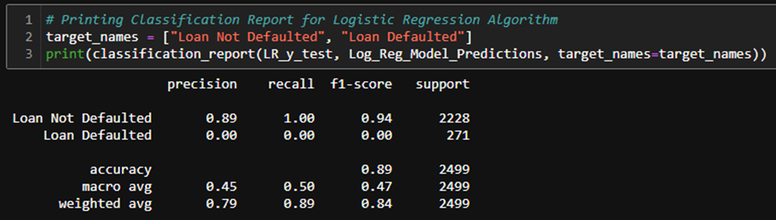
Logistic Regression Model Classification Report

Slide 8
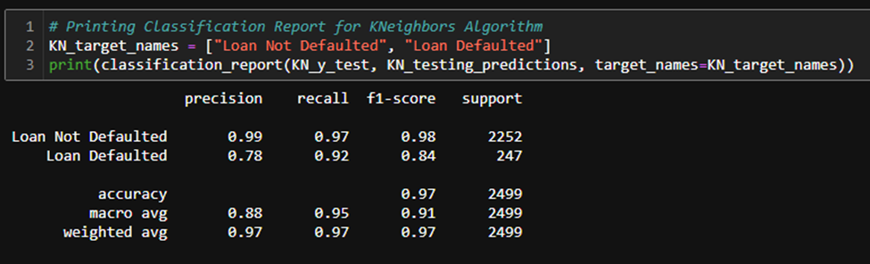
KNeighbors Model Classification Report

Slide 9
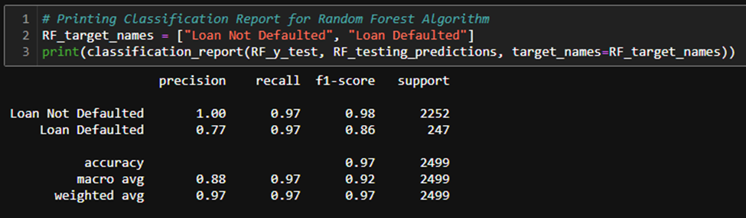
Random Forest Model Classification Report

Slide 10
Machine Learning Continued
In this scenario the KNeighbors algorithm is the better overall model for training the data. This is because in this model the loans that defaulted were predicted with 78% accuracy vs with 77% accuracy in the model created using the Random Forest algorithm. The model created using the logistic regression algorithm had an even worse precision accuracy score. It only predicted loans that didn’t default with 89% accuracy and predicted loans that did default with 0% accuracy so you wouldn’t want to use this model with this sort of data.

Slide 11
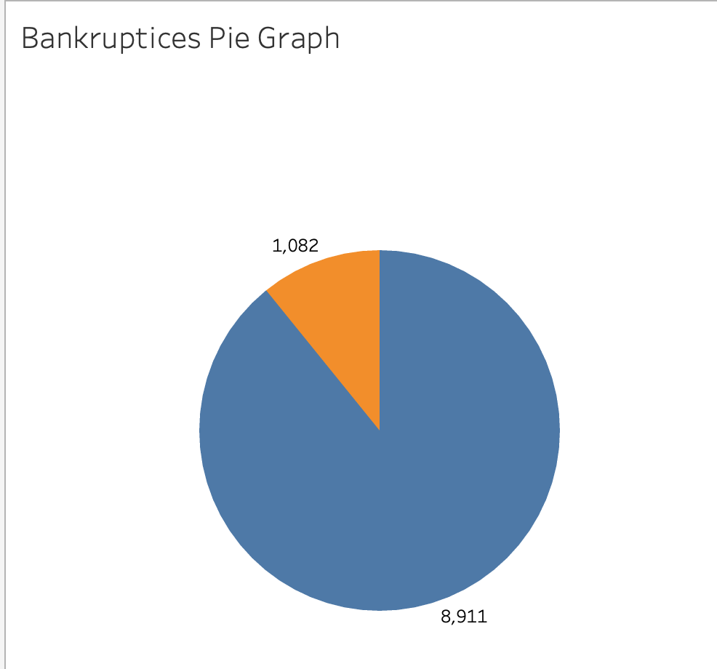
Visualizations from Tableau Part 1
Pie Graph of clients that had 1 or more bankruptcies vs those who had zero.
1,082 had bankruptcies, 8,911 did not.

Slide 12
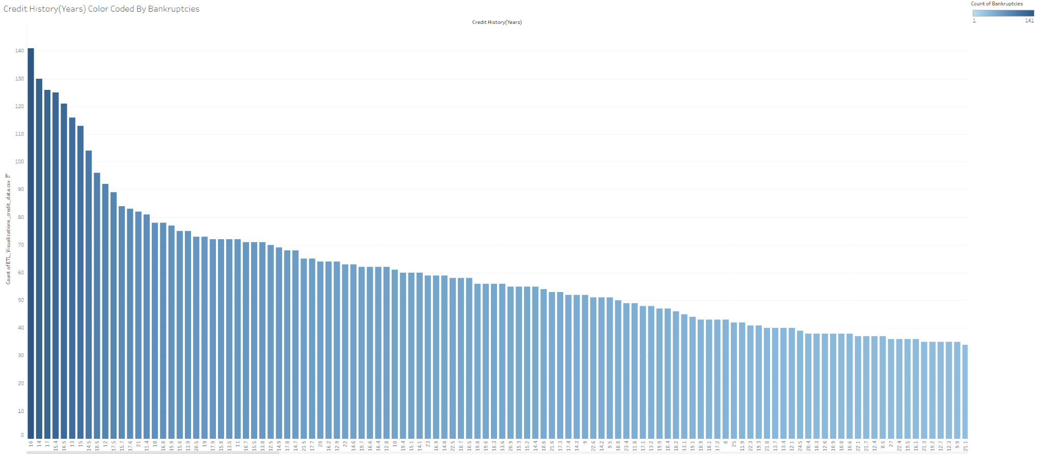
Visualizations from Tableau Part 2
This visualization is depicting the relationship between the number of years of credit history color coded by the count of bankruptcies. Those with less credit history tended to have more bankruptcies.

Slide 13
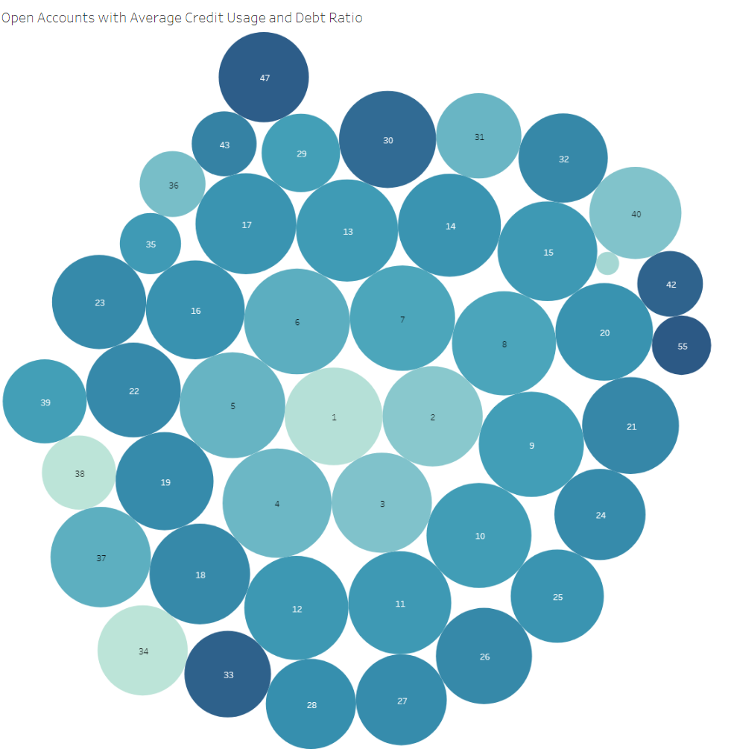
Visualizations from Tableau Part 3
This visualization shows the average debt to income ratio and credit usage ratio based on the the number of open accounts per individual.

Slide 14
Conclusion
As previously mentioned, a bias towards false positives is preferred because it will have the more significant impact for lenders acquiring new customers.
Having the ability to predict what percentage of clients will default on their loan, even though they said they wouldn’t, will help lenders mitigate risk, implement stricter qualification standards if necessary, and prepare for the worst case scenarios with more accuracy.
Overall more lenders will profit from this predictive model by knowing which risks they can and cannot accept and the quantity of risk they can accept as well.

Slide 15
Additional Sources
Our dataset located in "/Resources/credit_data.csv" originated from https://www.kaggle.com/datasets/zaurbegiev/my-dataset?select=credit_test.csv. We renamed it from "credit_test.csv" to "credit_data.csv".
The basis for the code used in the "Mounting Google Drive Account" section of "/ETL/ETL_colab.ipynb" was found from https://saturncloud.io/blog/exporting-dataframe-as-csv-file-from-google-colab-to-google-drive/.
The basis for the code used in the "Un-Mounting Google Drive Account" section of "/ETL/ETL_colab.ipynb" was found from https://stackoverflow.com/questions/54837135/how-to-unmount-drive-in-google-colab-and-remount-to-another-drive.
The basis for the code used in the "Dropping Rows 452, 537, 1752, 2680, 5861, 7083 and 9968 because we believe it has some erroneous data" section of "/ETL/ETL.ipynb" and "/ETL/ETL_colab.ipynb" came from https://pandas.pydata.org/docs/reference/api/pandas.DataFrame.drop.html.

